Slide 1
Large-Scale and Multi-Structured Databases Project Design Social News
Biondi Matteo
Burgisi Martina
Cristofani Federico

Slide 2
Application Highlights
Types of users: readers, reporters, and administrators.
Readers can search for reporters or posts, view and comment on posts, delete a comment follow reporters, view the most influential and popular reporters and view their own profile.
Reporters can post and delete articles, view statistics about most active time of the day and their own most popular posts, and view their own profile.
Administrators can view statistics about readers and reporters, register new verified reporters, search and delete registered users and comments/posts.
The system is a website application that uses encryption for passwords, secure communication and is available 24/7.
Available statistics include: most active readers, most popular reporters, gender statistics, nationality statistics, hot posts of the day, most active moment of the day and new suggested reporters

Slide 3
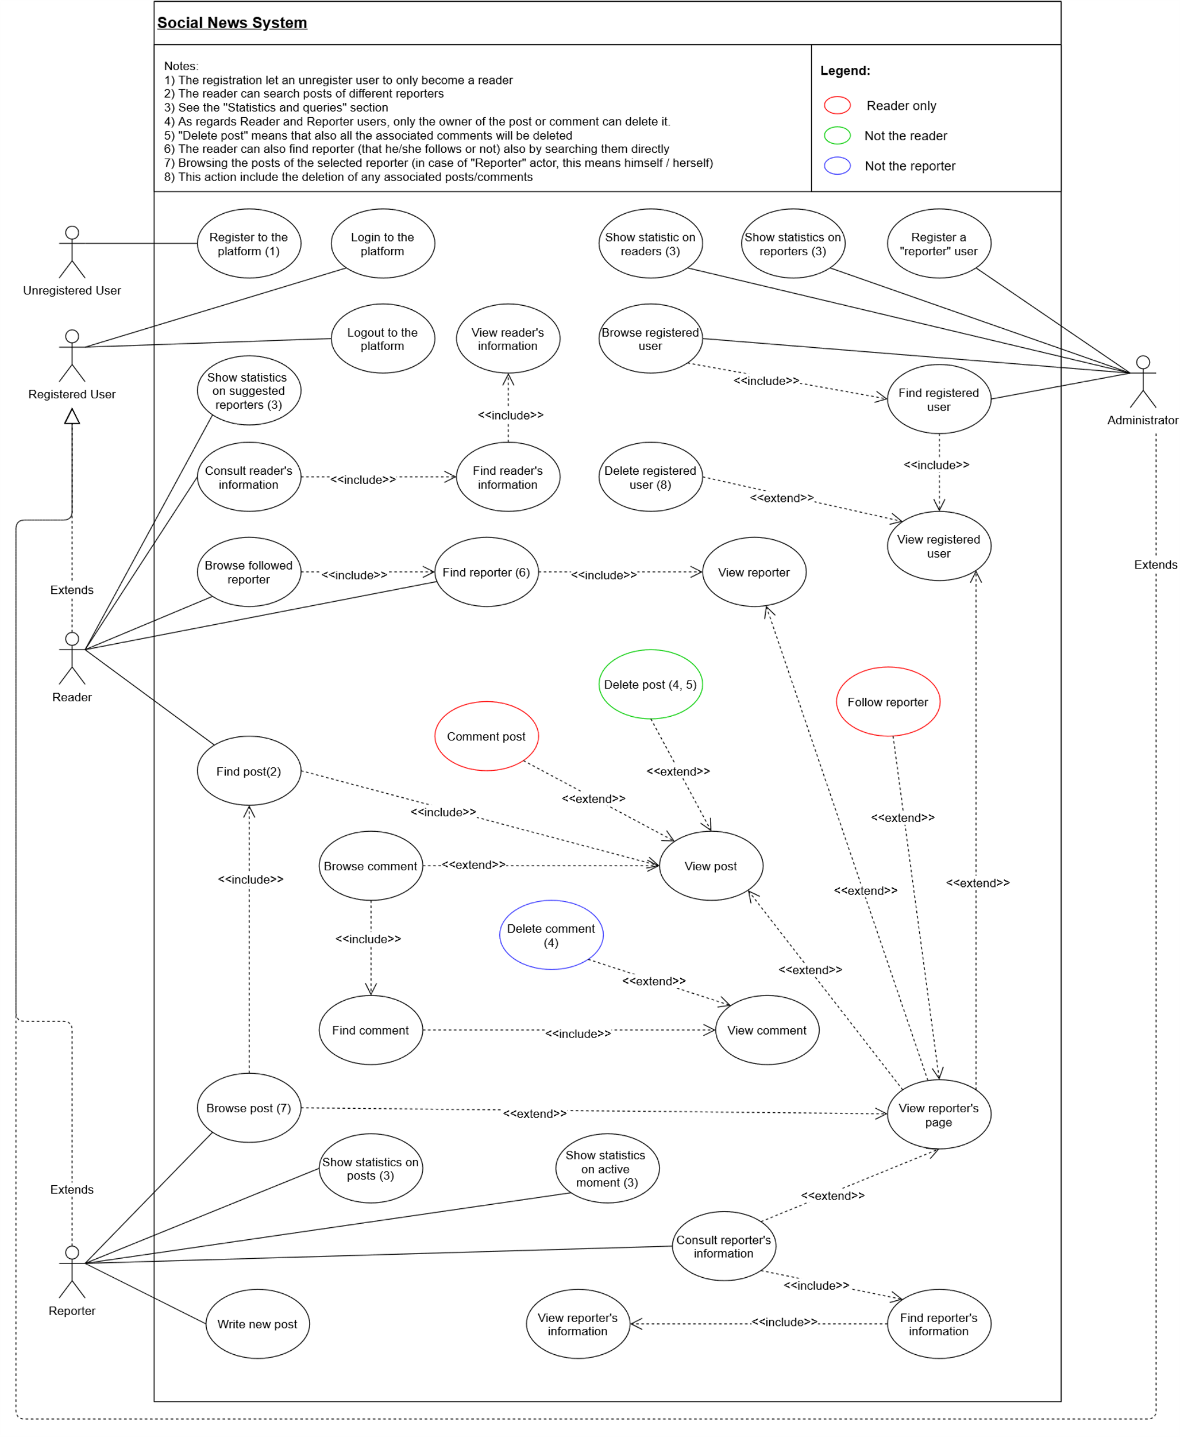
Actors and main supported functionalities

Slide 4
Dataset Description
Source:
https://github.com/jbencina/facebook-news
https://www.kaggle.com/datasets/bwandowando/breaking-news-twitter-dataset
https://randomuser.me/
Description:
Facebook posts and comments on news outlets pages
Breaking news tweets
Randomly generated users
Volume:
Post\Tweet and comments after being cleaned at least 104MB
Generated users 150.000, estimated considering number of real authors of comments and posts
Variety:
Data comes from two different sources (Twitter and Facebook)
Some data attribute are optional

Slide 5
Preliminary UML Class Diagram

Slide 6
Requirements and Entities handled by Document DB
Entities:
User (Reader, Reporter, Admin)
Post
Comment
Statistics and queries:
Most active readers, reader with highest number of comments in the last period
Gender\Nationality statistics, readers per gender\nationality in the system
Hot posts of a reporter, top 10 most commented posts of a reporter
Most active moment of the day

Slide 7
Requirements and Entities handled by Graph DB
Entities:
User (Reader, Reporter)
Graph DB maintains only the essential information to handle the “follow” relationship between readers and reporters
Relationship are unidirectional and the only ones admitted are from reader to reporter
Statistics and queries:
Given a reader, retrieve his\her followed reporters
Most popular reporters, reporter with highest number of followers
Suggest the most followed reporters that reader doesn’t follow yet

Slide 8






Software Architecture Preliminary Idea
Java EE webapp
Tomcat application server
MongoDB and Neo4J databases
Server-side dependencies resolved by Maven
Client user interface build via Bootstrap components and Javascript
Client-side
Server-side

